Slide 1
Contents
Basic concepts of software testing
Software testing technology(method)
Software testing process(content)
Software testing automation
Software testing management
Software maintenance

Slide 2
Basic concepts of software testing
A crash is when your competitor’s program dies.
When your program dies, it is an “idiosyncrasy”（行为异常）.
1 Software Testing Background
2 The Software Development Process
3 The Realities of Software Testing

Slide 3
1. Software Testing Background
How software bugs impact our lives
What bugs are and why they occur
Who software testers are and what they do

Slide 4
Infamous Software Error Case Studies
Disney's Lion King, 1994——1995
Intel Pentium Floating-Point Division Bug, 1994
(4195835 / 3145727) * 3145727 - 4195835
NASA Mars Polar Lander, 1999

Slide 5
Infamous Software Error Case Studies
Patriot Missile Defense System, 1991
The Y2K (Year 2000) Bug, circa 1974
Dangerous Viewing Ahead, 2004

Slide 6
What Is a Bug?
Defect | Variance
Fault | Failure
Problem | Inconsistency
Error | Feature
Incident | Bug
Anomaly
Product Anomaly Reports (PARs)
Product Incident Reports (PIRs)

Slide 7
Software Bug: A Formal Definition
1. Doesn’t do something it should do.
Does something it shouldn’t do.
Does something it doesn’t mention.
Doesn‘t do something it doesn’t mention but should.
It’s difficult to understand, hard to use, slow, or——in the software tester's eyes——will be viewed by the end user as just plain not right.
product specification

Slide 8
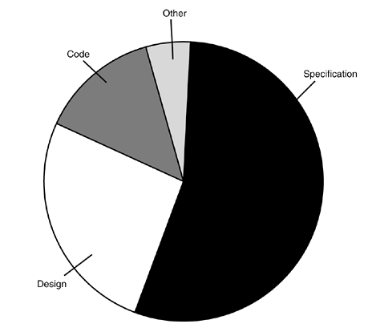
Why Do Bugs Occur?
10%
7%
56%
27%

Slide 9
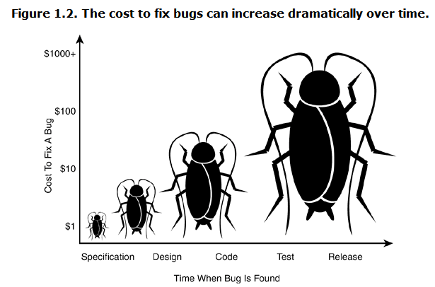
The Cost of Bugs

Slide 10
What Exactly Does a Software Tester Do?
● The goal of a software tester is to find bugs.
● The goal of a software tester is to find bugs and find them as early as possible.
● The goal of a software tester is to find bugs, find them as early as possible, and make sure they get fixed.

Slide 11
What Makes a Good Software Tester?
● relentless
● creative
● good judgment
● tactful and diplomatic
● persuasive
●software programming
●expert in non-computer field

